Slide 1
Project 3 Checklist

Slide 2
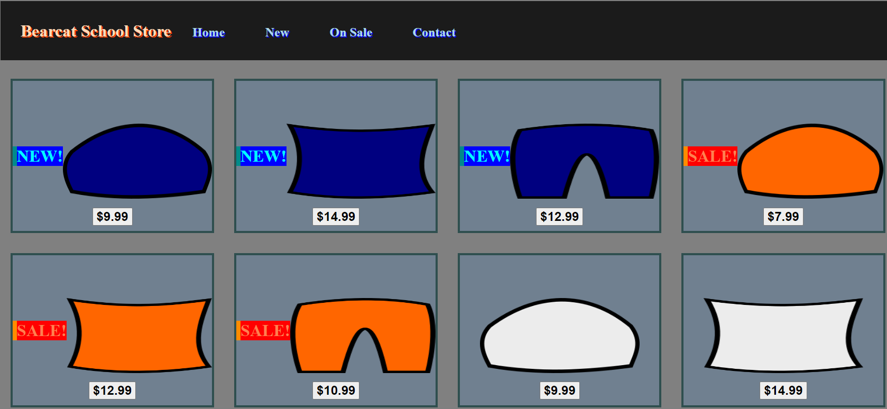
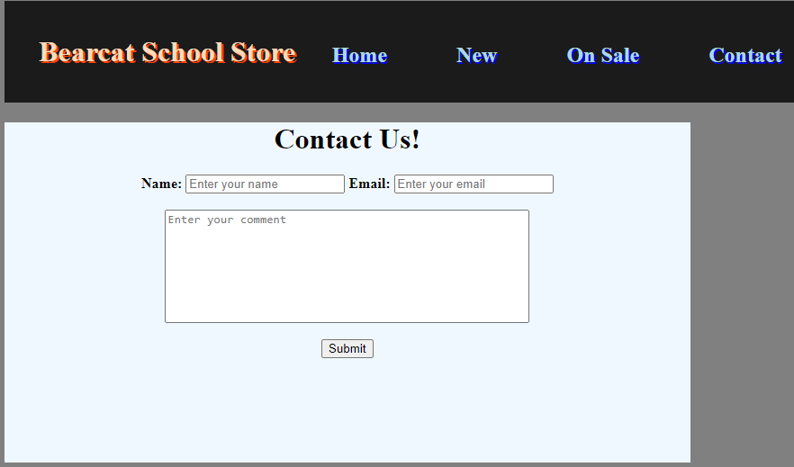
Project Overview

Slide 3
Day 1: Create Images For Products
Pillow
Pants
Beanie

Slide 4
Day 1: Create Images For Products
Beanie
HTML (home.html)
<img src=“image1.png”>
<img src=“image2.png”>
<img src=“image3.png”>
Pillow
Pants

Slide 5
Day 2: Create An Item Container
New Item
Sale Item
Regular Item

Slide 6
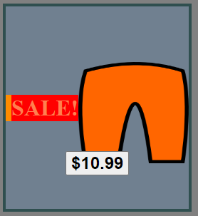
Day 2: Create An Item Container
CSS (styles.css)
#itemContainer{
border: 4px solid darkslategray;
background-color: slategrey;
height: 30%;
width: 20%;
float: left;
display: flex;
margin: 1%;
align-items: center;
justify-content: center;
}
#itemContainer:hover{ background-color: gold;}
#itemImage {
width: 80%;
height: 50%;
padding-top: 5%;
margin-left: auto;
margin-right: auto;
}
#sale {
border-left: 8px solid darkorange;
color: coral;
float: right;
font-weight: bold;
font-size: xx-large;
background-color: red;
cursor: default;
}
HTML (home.html)
<link rel="stylesheet" href="styles.css">
<div id=“itemContainer”>
<div id=“sale”>
SALE!
</div>
<img id=“itemImage” src=“orange-pants.png”>
<button>
<b>
$10.99
</b>
</button>
</div>

Slide 7
Day 3: Create The “All Items” Display
Combine New, Sale, and Regular Items in an organized manner

Slide 8
Day 3: Create The “All Items” Display
HTML (home.html)
<div id="store">
<!-- blue hat item container -->
<!-- blue pillow item container -->
<!-- blue pants item container -->
<!-- orange hat item container -->
<!-- orange pillow item container -->
<!-- orange pants item container -->
<!-- white hat item container -->
<!-- white pillow item container -->
</div>

Slide 9
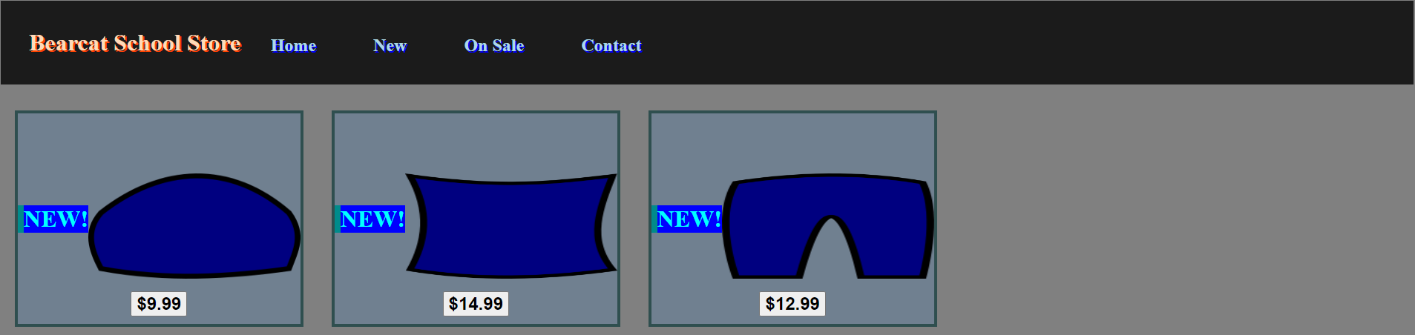
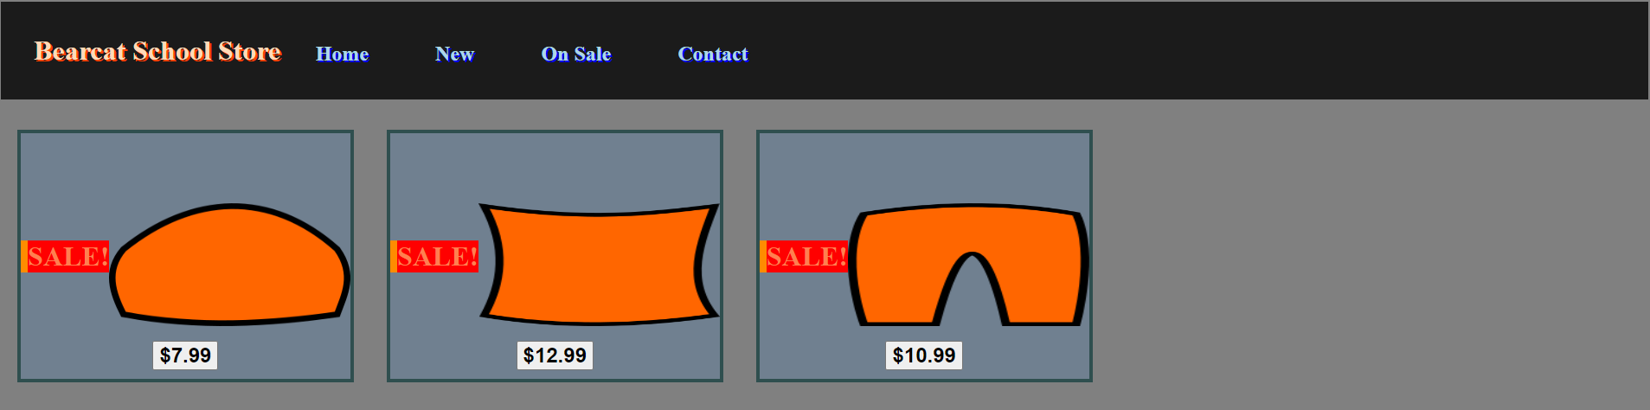
Day 4: Create the “New” and “Sale” Pages

Slide 10
Day 4: Create the “New” and “Sale” Pages
HTML (new.html)
<link rel="stylesheet" href="styles.css">
<div id="store">
<!-- blue hat item container -->
<!-- blue pillow item container -->
<!-- blue pants item container -->
</div>

Slide 11
Day 4: Create the “New” and “Sale” Pages
HTML (sale.html)
<link rel="stylesheet" href="styles.css">
<div id="store">
<!-- orange hat item container -->
<!-- orange pillow item container -->
<!-- orange pants item container -->
</div>

Slide 12
Day 5: Create the Header
A tab for each page that navigates to that page upon clicking

Slide 13
Day 5: Create the Header
CSS (styles.css)
ul{
background-color: rgb(27, 27, 27);
padding: 2%;
} li{
display: inline;
padding: 2%;
color: lightblue;
font-size: x-large;
text-shadow: 2px 2px blue;
font-weight: bold;
text-decoration: none;
}
li:hover{ background-color:slategrey; }
a{ text-decoration: none; }
span{
color: peachpuff;
font-size: xx-large;
font-weight: bolder;
cursor:no-drop;
text-shadow: 2px 2px orangered;
} span::selection{ background-color: transparent; }
HTML (every html file)
<header>
<link rel="stylesheet" href="styles.css">
<ul>
<span> Bearcat School Store </span>
<a href="index.html">
<li>Home</li>
</a>
<a href="new.html">
<li>New</li>
</a>
<a href="sale.html">
<li>On Sale</li>
</a>
<a href="contact.html">
<li>Contact</li>
</a>
</ul>
</header>

Slide 14

Day 6: Create The Contact Form

Slide 15
Day 6: Create The Contact Form
HTML (contact.html)
<div style="background-color: aliceblue; width: 40%; height: 40%; text-align: center">
<h1>Contact Us!</h1>
<form>
<b>
Name: <input type="text" placeholder="Enter your name">
Email: <input type="text" placeholder="Enter your email">
</b>
<br><br>
<textarea style="resize:none" placeholder="Enter your comment" cols="52" rows="8"></textarea>
<br><br>
<input type="button" value="Submit" onclick="submit()">
</form>
</div>

Slide 16
Day 7: Catchup / Bonus
Add a product page that contains information for each product that is linked to the image of the product on the products page(s)
Create an item container for out-of-stock items
Create a form for users to create accounts and log in
Create a form for store owners to add new products
Review code to ensure it is easy to read and well-organized

